Slide 1
Registry & OTP Arrest Efforts Arrest and Surrender of Mr Cezar Mull

Slide 2
1. Issuance of Arrest Warrant against Cezar Mull
Public
Confidential
Under Seal
Secret
Notes:
In January 2019, a Pre-Trial Chamber of the ICC issues an under seal Warrant of Arrest against Minister of Defence of the Republic of Brazana, Mr Mull
Mr Mull is allegedly responsible for crimes against humanity and war crimes committed on the territory of Brazana between June and September 2018

Slide 3
2. Political Analysis Republic of Brazana
Republic of Brazana ratified of the Rome Statute on 8 February 2001
Analyze prospects for execution of arrest warrant and potential political factors
Identify strategic partners with significant political influence over Republic of Brazana
Strategic recommendations

Slide 4
3. Develop profile of Mr Mull and Tracking Strategy
Human Intelligence Sources
Identify potential intermediaries
Establish connections
Open-Source Intelligence
Track social media accounts of Mr Mull and associates
Map and evaluate activities of Mr Mull
Intelligence provided by States Parties
Satellite Images
Track (logistical) movements around Mr Mull
Information Analysis

Slide 5
4. Implementation of Registry & OTP Tracking Strategy
Maintained continuous contact with intermediaries who can potentially provide information
Determine exact location
Analysed information, monitor activities, assess movement patterns to determine exact location
Liaised with existing rewards programmes to provide additional incentives
WHICH COUNTRY SHOULD BE NOTIFIED OF THE ARREST WARRANT
AND THE REQUEST FOR ARREST AND SURRENDER?
Notes:
Icons source https://www.flaticon.com/free-icon/united-states-of-america_555526

Slide 6
quality of information given by intermediaries allows us to identify the exact location and anticipated moves of the suspect within one country
5. Arrest Opportunities
The Court is informed that in January 2021 Mr Mull
travels to the Republic of Garrons (ICC State Party) for a bilateral meeting
1st Scenario: Travel of Suspect and notification to ICC State Party
2nd Scenario: Quality of information given by intermediaries allows the Court to identify the exact location and anticipated moves of the suspect within one country
Notes:
Icons source https://www.flaticon.com/free-icon/united-states-of-america_555526 5 Diplomatic Steps: Mention that information might be communicated to state party or organization – if applicable/relevant

Slide 7
8. Registry & OTP – Example for successful arrest 2024
Sufficient information to start sustained engagement with States – Re-transmit the RAS and Dossier with all information to the State
ICC urgently transmits a request for arrest and surrender to the authorities of Garrons
Registry & OTP joint high-level mission to secure political support
Registry operationalization of Recommendations engaging with four States
Requested State successfully conducted arrest operation, thanks to detailed information and intelligence provided by Registry and OTP
Notes:
Registry Requests for Arrest and Surrender – For Requests for Arrest and Surrender, the Registry aims to provide a “full package” to the requested States, including intelligence, support from various States, information from private actors relating to the probable location of a suspect; High-level mission Determined exact location: -Registry sources: Receiving detailed information about activities, level of protection, and most frequented locations of suspect -Registry & OTP efforts in Suspects at Large Working Group: wider analysis of remote and hard-to-access area – providing satellite imageries and cartographic details along with Request for Arrest and Surrender Successful cooperation -In this scenario, Registry operationalized Recommendations for activities on suspects at large on a situation level, as well as operational level – involving four States in successful arrest operation

Slide 8
6. ICC Key Challenges Related to Suspects at Large
Legal
Political Support/ Judicial Cooperation
Operational
Risk of Leaks
Enhancing exchanges between ICC and States Parties on Arrest related matters
Notes:
Operational:
Identifying location of suspect
Lack of intelligence/ information on the probable location of suspects
Limited capacities and resources
Political support/Judicial Cooperation
Lack of cooperation in an effective and timely fashion
Lack of political willingness to cooperate with the Court on arrest and surrender of suspects
Sensitive nature of arresting and surrendering ICC suspects at large → considerations about potential political consequences
Travels of high-level suspects at large, including sitting heads of States, to ICC States Parties is occupying high amount of time, resources, and capacities
Legal
Absence of sufficient implementing legislation for ICC cooperation requests
Technical delays due to intricate national legal procedures unknown to Registry
Risk of Leaks
Risk of Leaks particularly problematic for under seal or secret arrest warrants
Conclusion Operationalization of Recommendations key priority for 2025 → Encourage States to proactively reach out to the Court

Slide 9
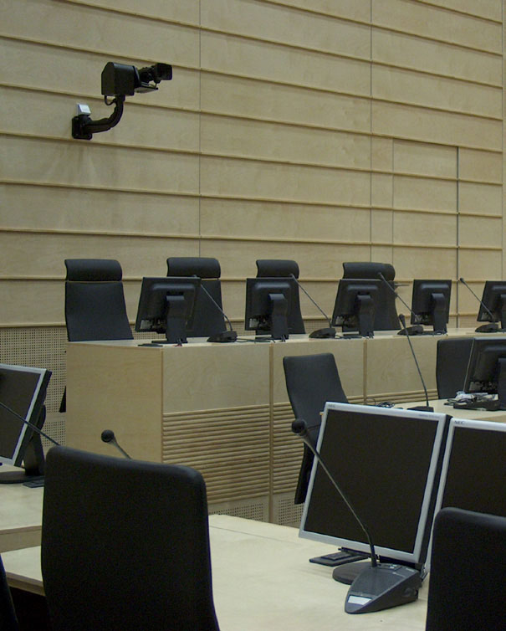
THANK YOU FOR YOUR ATTENTION

