Slide 1
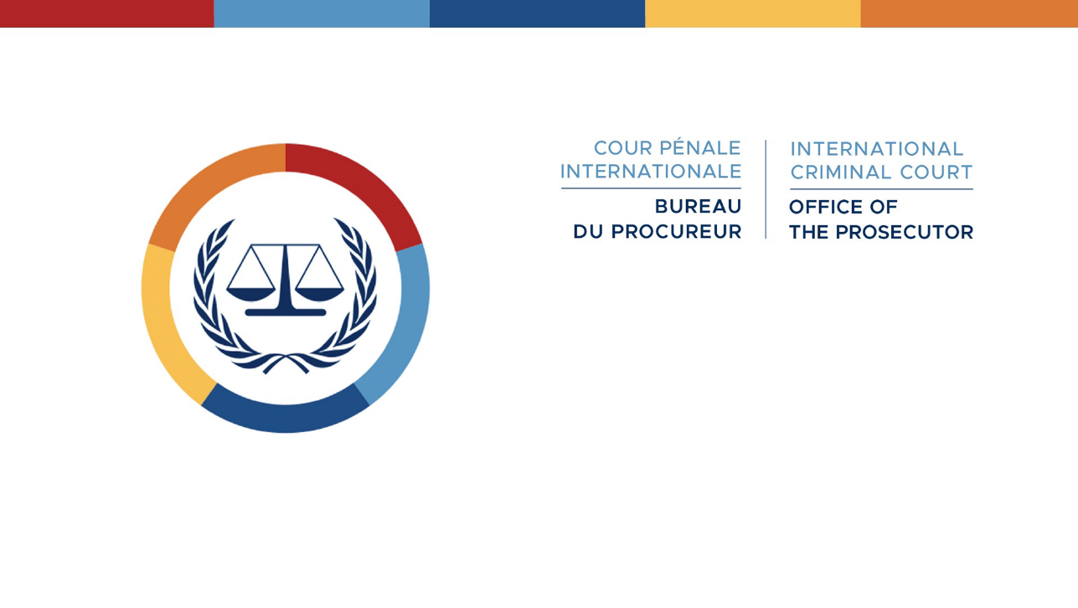
      Structured ENGAGEMENT ON SECURITY AND PROTECTION OF WITNESS
ASSEMBLY OF STATES PARTIES
24th SESSION – COOPERATION PLENARY
4 DECEMBER 2025

Slide 2

Why Witness Security and Protection Matters
Why Witness Security and Protection Matters
Why it Matters
  Investigations involving witnesses in more than 70 countries under 16 investigations
  Largest number of protection requests
  Diverse, high-risk witnesses
  Limited relocation agreements → delays
Risks to OTP Witnesses and Cases
Risk 1: No safe places → loss of evidence, harm to witnesses
Risk 2: Delays → witnesses leave, cases collapse
Consequences: Sacrifice of witnesses loses meaning, justice denied.
Notes:
Original slide 1

Slide 3
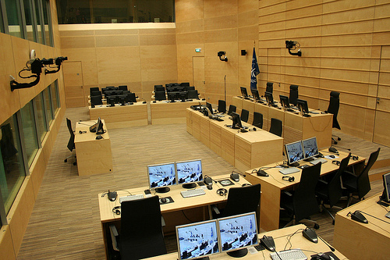
What can States do to assist ?
  Cooperation in all regions to secure increasingly dispersed and diverse witness population ( 70+ countries)
  State assistance with organising interviews/activities and post interview/activity follow-up
  Witness security & protection is a lifeline
  States’ support for short-term entry
  Without structured cooperation and support to witnesses→ evidence lost, justice lost
Notes:
Original slide 1

Slide 4
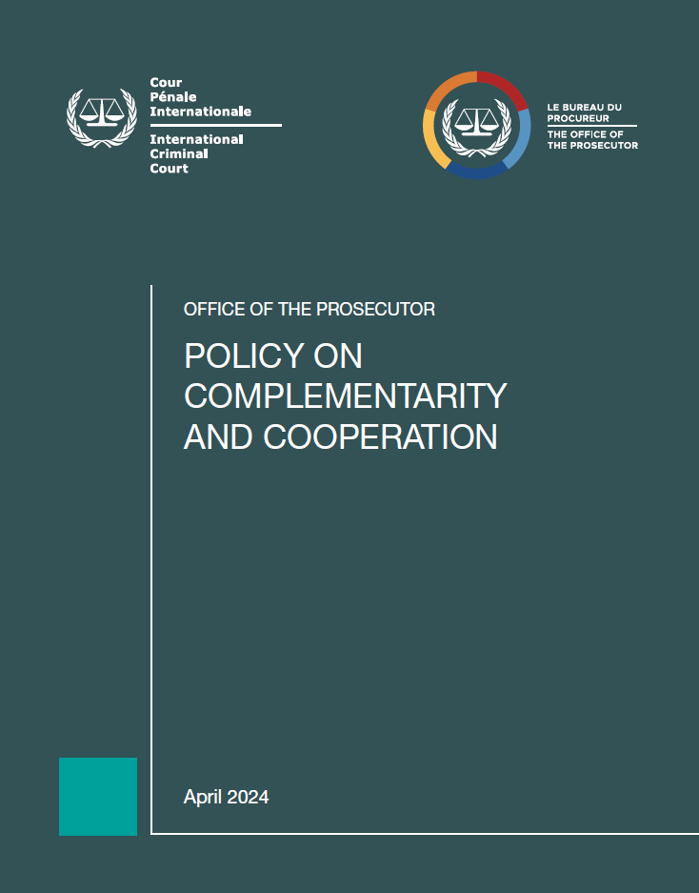
Complementarity and Cooperation Forum
Witness Security Group
Raise awareness on the witness security management
Understand the States’ requirements and legal framework
Establish tools to facilitate cooperation with States
Informative forum, webinars and regional technical-level seminars
Explore best practices and methodology with States(together & bi-laterally)
Notes:
Capacity building in international criminal justice for DRC judiciary actors and magistrates as well as national human rights actors in Kinshasa, DRC (completed in August 2024).
Capacity building for CAR Special Criminal Court (judicial cooperation, SGBC, witness protection, etc.) (upcoming October 2024).
Forensic Rotational Model:

Slide 5
I. General Principles
Complementarity and Cooperation Forum
A tool for national authorities
Global Hub for Cooperation
Community of Practitioners
Unique and holistic interface for information sharing and exchange of expertise
Fostering synergy between the international and national levels
OTP Support
Deepening baseline understanding across situations of how OTP can support national authorities
Enable better coordination of efforts on investigations into international crimes, by reducing duplication of effort
Notes:
Al Hassan Background: Mr Al Hassan is accused of crimes against humanity and war crimes allegedly committed in Timbuktu (Mali). The trial in this case opened on 14-15 July 2020. 52 oral witnesses were called by the Prosecution at this stage and 22 Defence witnesses appeared in court. The Legal Representatives of Victims, representing 2196 victims in this case, also called two witnesses to testify. On 8 February 2023, Trial Chamber X declared the closure of the submission of evidence in this case and parties and participants were requested to file their final briefs. The closing statements of the Prosecution, the Legal Representatives of Victims and the Defence took place from 23 to 25 May 2023.
Kony:The Rome Statute allows for the confirmation of charges proceedings at the Pre-Trial stage in the absence of the suspect. If the charges are confirmed, the case can only proceed to trial if the accused is present before the Trial Chamber. The existence of confirmation proceedings in absentia would serve to expedite the case against a suspect that cannot be found, however, as held previously by the same Chamber, this proceeding is only applicable in exceptional circumstances. .
The Chamber, composed of Judge Rosario Salvatore Aitala, Presiding, Judge Tomoko Akane and Judge Sergio Gerardo Ugalde Godínez, had previously already considered that Mr Kony qualifies as a “person who cannot be found” within the meaning of article 61(2)(b) of the Rome Statute. Now, after a targeted Outreach campaign launched by the Registry for this purpose, the Chamber further concluded that “all reasonable steps to inform Mr Kony of the charges against him as set out in the Document Containing the Charges have been taken”. It noted the ICC Registry’s efforts to that effect including large-scale media campaigns in Acholi and in English, both in Uganda and neighbouring countries, activities aiming at engaging with relevant stakeholders and communities, such as religious and cultural leaders, civil society actors, victims groups and local government leaders, as well as meetings attended by clan members and other persons close to the suspect.
Venezuela:the Appeals Chamber rejected all six grounds of appeal submitted by Venezuela. In examining the grounds of appeal, the Appeals Chamber, among other conclusions, recalled its recent ruling, in the Philippines Judgment, that “the burden of providing information relevant to the pre-trial chamber’s determination under article 18(2) of the Statute remains on the State seeking deferral”.
The Appeals Chamber also considered that the focus of the Pre-Trial Chamber’s assessment was correctly on “whether Venezuela was conducting or had conducted any investigations or prosecutions of the same categories of individuals, that is alleged high-ranking members of the State security forces and pro‑government individuals, in relation to the relevant criminality”.
Furthermore, the Appeals Chamber discussed the issue of whether domestic investigations must cover contextual elements of crimes against humanity, such as the existence of a widespread or systematic attack against a civilian population or a policy. The Appeals Chamber considered that “the legal interests protected by each crime can be discerned by reference to the elements of that specific crime”. It also found that in order to pursue the legal interests protected by crimes against humanity, a State, which, like Venezuela, has not incorporated crimes against humanity in its domestic law, while not required to investigate the alleged criminal acts under the legal qualification of crimes against humanity, must nevertheless investigate the factual allegations underpinning the contextual elements of such crimes”. The Appeals Chamber highlighted that while the Rome Statute does not expressly impose an obligation on States Parties to incorporate the crimes against humanity in their domestic legislation, “such incorporation may facilitate the fulfilment of their duty” to exercise criminal jurisdiction over “those responsible for international crimes”.
On other issues, the Appeals Chamber considered that Venezuela misrepresented the Impugned Decision and made unsubstantiated arguments on other points.

Slide 6
Thank you for your attention
Security and protection Unit &
External Affairs Unit
Office of the Prosecutor
Notes:
Original slide 1

